Slide 1
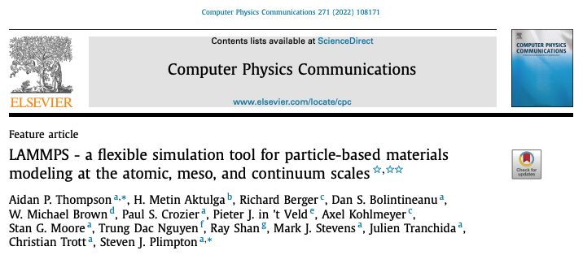
LAMMPS

Slide 2
Preliminaries…
Need to have installed LAMMPS binary + examples package on your Google Drive FIRST
From the email:
Go to https://github.com/BKFC90/Sofia2023
Click on Sofia2023_Setup
When the window opens, click “Open in Colab”
Run the complete notebook via Runtime->Run all
Load the Examples notebook for today:
Go to https://github.com/BKFC90/Sofia2023
Click on Sofia2023_Examples
When the window opens, click “Open in Colab”

Slide 3
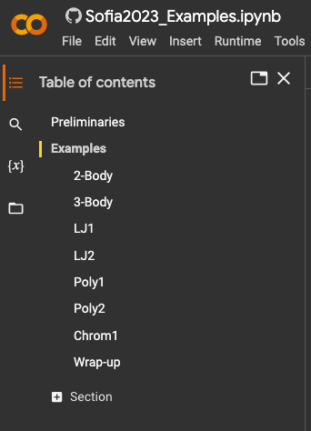
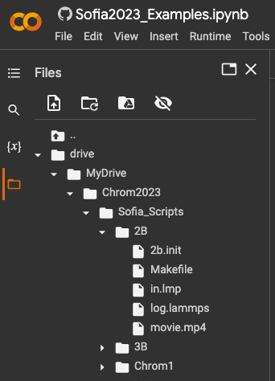
notebooks
scripts
double-click to edit

Slide 4
LAMMPS: Large-scale Atomic/Molecular Massively Parallel Simulator
Capabilities:
Atomistic Simulations
Materials Modeling
Thermal and Mechanical Properties
Reaction Kinetics
Phase Transitions
Mesoscale Simulations
Usage Examples:
Biomolecular Dynamics
Materials Research
Nanotechnology
Energy and Catalysis
Resources (very large user community!):
Website: Visit the official LAMMPS website for documentation, tutorials, and downloads.
User Forums: Engage with the LAMMPS community for support and collaboration.
Examples: Explore online tutorials, example inputs, and publications related to LAMMPS.

Slide 5
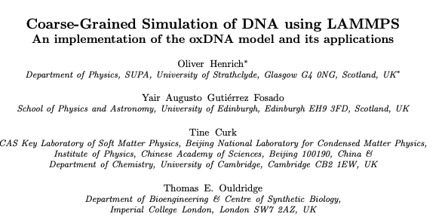
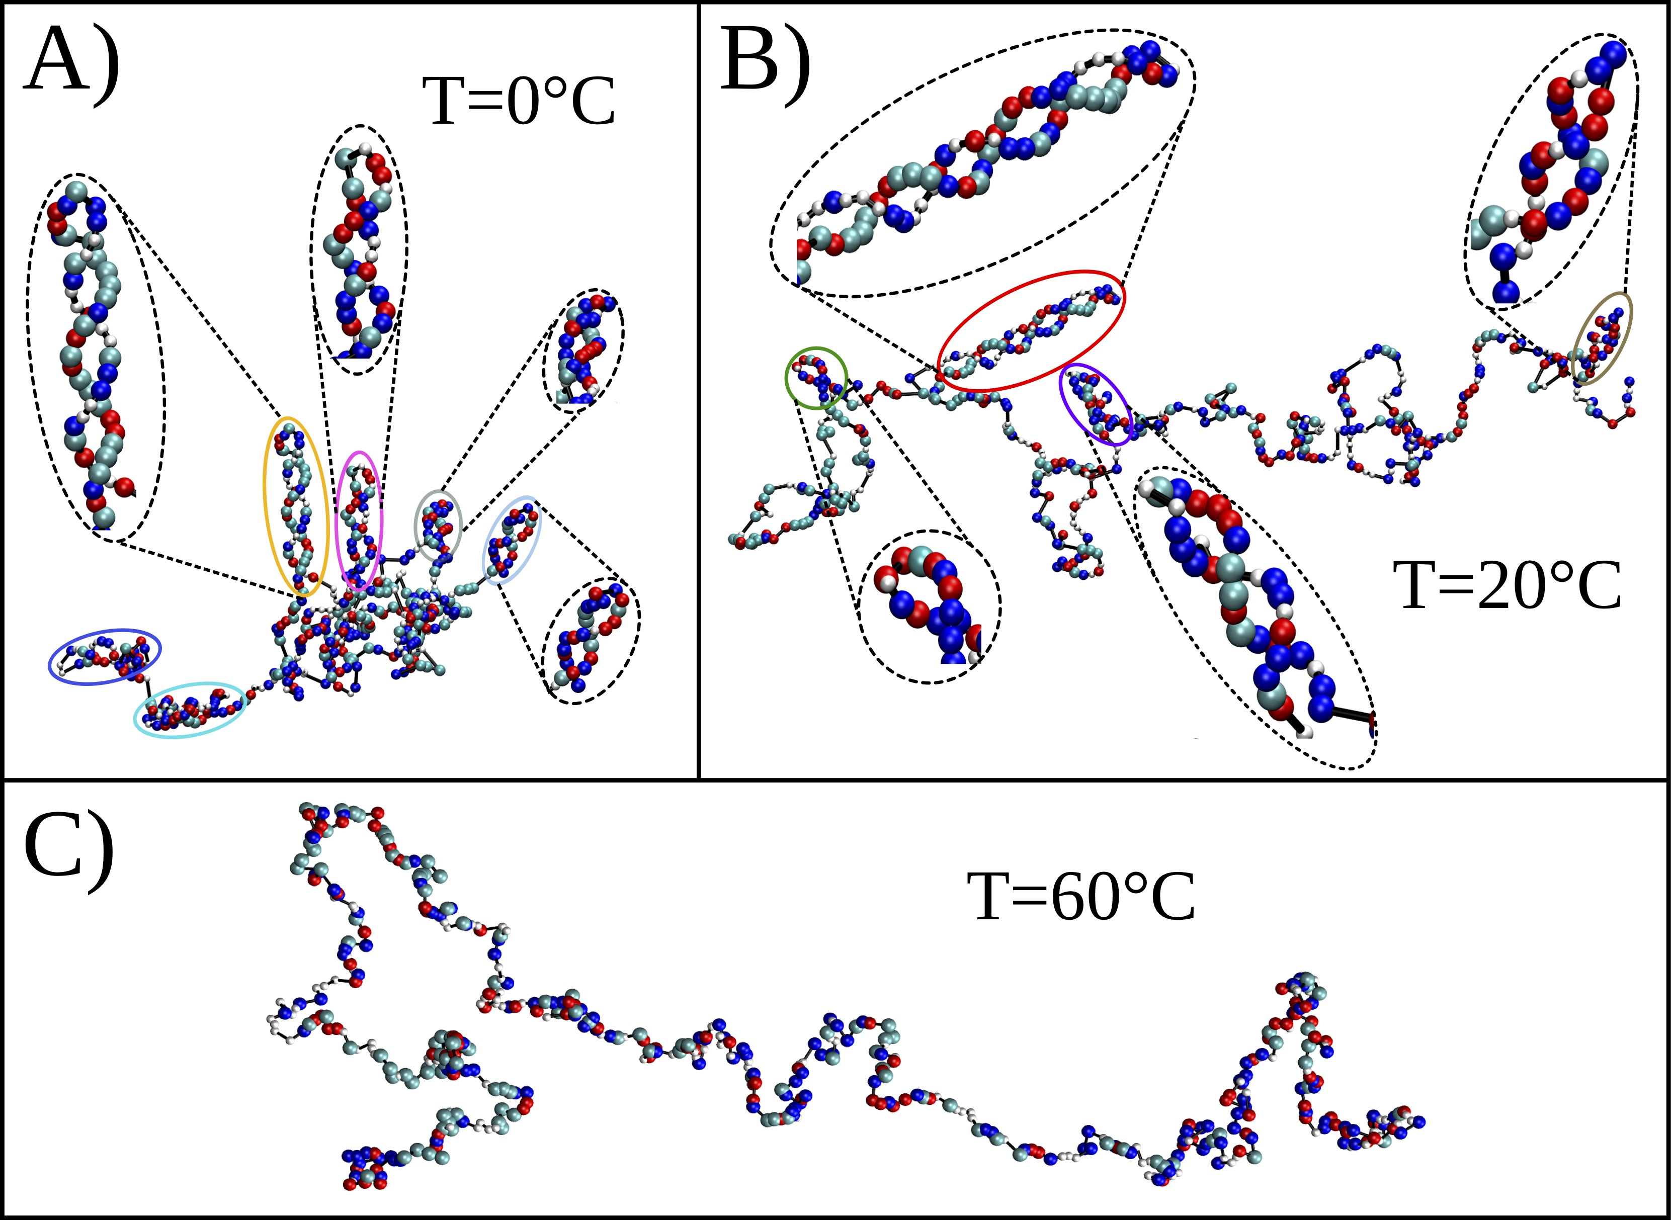
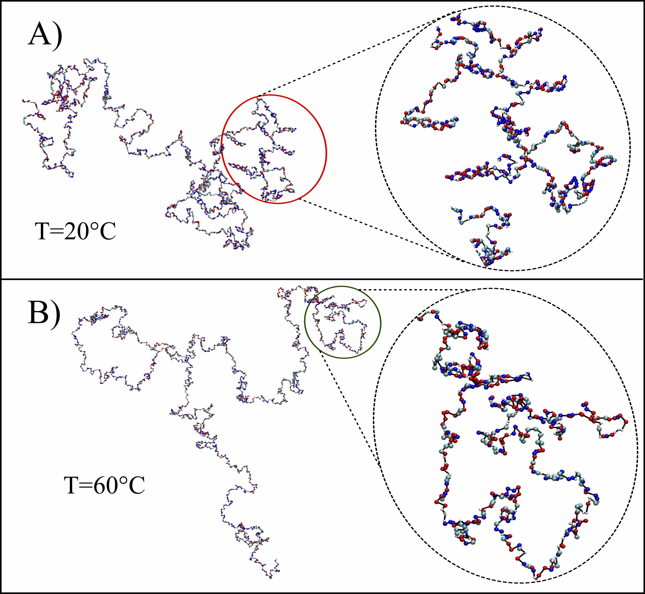

Slide 6
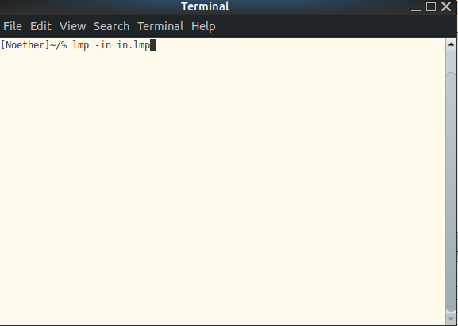
Running LAMMPS in Production
LAMMPS is a package that must be built or installed on a computer
Pre-built (Ubuntu Linux)
Build from source
Instructions at LAMMPS site
Personal computers OK, but probably need fast multi-core for efficient running
LAMMPS is normally run in an xterm session
xterms available in Windows, Linux, MacOS
Even on multi-core HPC machines, production runs can take many hours. Also, several hours of HPC might represent 1 microsecond of real time.
Check the LAMMPS documentation for achieving optimal use of multi-core, MPI vs MP, and GPUs for your application.

Slide 7
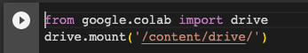
Role of Google Colaboratory for Today
Everyone running the same (Google) virtual machine, with LAMMPS installed
No bandwidth/CPU bottlenecks with shared machines
Colab is a ‘window’ onto a Linux machine
Each notebook cell is a mini Linux xterm session, but with each xterm command preceded by ‘!’:
!xterm_command
Execute the commands in the cell by ‘running’ it

Slide 8
Plan of Lecture
Explore a series of examples, beginning with an analogy to “Hello, World!”
Continue to a model of two chromosomes in a cell nucleus
All LAMMPS script files in Google Drive, and they can be used anywhere (not just in Google Colab)
Example scripts are heavily annotated with comments so that you can go back and review.
You can edit the scripts ‘live’ during this session, but changes won’t be saved

Slide 9
Writing LAMMPS Scripts…
LAMMPS is a scripting language:
scripts are used as input to the LAMMPS executable for runs (what makes it fast)
not an interactive interpreter
It’s not GUI, but a huge number of options
It’s a powerful language, BUT
Learning curve (many options)
Errors not often handled gracefully
What should be standard practice:
Start simple and build up
Save versions often
There is community support, but spend time with the (extensive) documentation.

Slide 10
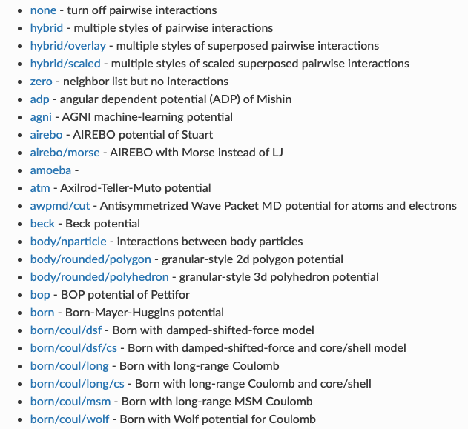
Many LAMMPS Options…
Pair-wise interactions:
--etc.--

Slide 11
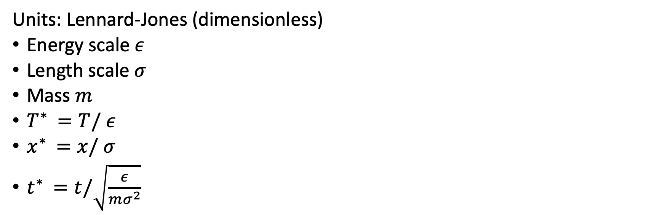
Example: 2-Body System: Simplest Script
Units: Lennard-Jones (dimensionless)
Energy scale $ε$
Length scale $σ$
Mass $m$
$T^{∗ }=T/$ $ε$
$x^{∗ }=x/$ $σ$
$t^{∗ }=t/\sqrt{\frac{ε}{mσ^{2}}}$

Slide 12
Example: 2-Body System: the first LAMMPS script
In.lmp:
# anything following ‘#’ is a comment
Units lj
boundary f f f # stands for fixed boundaries in the x y z directions
atom_style atomic # (vs molecular)
read_data 2b.init # this file has configuration information
pair_style yukawa 0.00001 20.0 # kappa cutoff
pair_coeff * * -10.0 20.0 # '*' means all particle types
dump M all movie 500 movie.mp4 type type size 1000 1000 view 60 120
dump_modify M backcolor white boxcolor black
dump_modify M adiam 1 3.0
fix F1 all nve # ‘fix’ commands tell LAMMPS how to run
run 100000 # default timestep is 0.01 LJ units of time

Slide 13
Example: 2-Body System: configuration file
# how many of each
2 atoms
0 bonds
0 angles
0 dihedrals
# types
1 atom types
0 bond types
0 angle types
0 dihedral types
# simulation volume
-20 20 xlo xhi
-20 20 ylo yhi
-20 20 zlo zhi
# particle masses
Masses
1 100.0
# initial positions
Atoms
1 1 0 0 5.0
2 1 0 5.0 0
# initial velocities
Velocities
1 0.1 0 0
2 -0.1 0 0
2b.init:
To run LAMMPS at Linux prompt:
lmp –in in.lmp
At Google Colab prompt:
!lmp –in in.lmp

Slide 14
Example: 2-Body System: LAMMPS Output
# FILE log.lammps
Generated 0 of 1 mixed pair_coeff terms from geometric mixing rule
Neighbor list info ...
update every 1 steps, delay 10 steps, check yes
max neighbors/atom: 2000, page size: 100000
master list distance cutoff = 20.3
ghost atom cutoff = 20.3
binsize = 10.15, bins = 4 4 4
1 neighbor lists, perpetual/occasional/extra = 1 0 0
(1) pair yukawa, perpetual
attributes: half, newton on
pair build: half/bin/atomonly/newton
stencil: half/bin/3d
bin: standard
# running output (can modify format)
Per MPI rank memory allocation (min/avg/max) = 3.449 | 3.449 | 3.449 Mbytes
Step Temp E_pair E_mol TotEng Press
0 0.65333333 -0.99995 0 -0.50995 -2.0833332e-07
100000 0.77451116 -1.0908334 0 -0.50995 7.3836847e-07
Loop time of 16.4969 on 16 procs for 100000 steps with 2 atoms

Slide 15
Example: 2-Body System: LAMMPS Output
# performance summmary
Performance: 2618666.121 tau/day, 6061.727 timesteps/s
47.2% CPU use with 16 MPI tasks x 1 OpenMP threads
MPI task timing breakdown:
Section | min time | avg time | max time |%varavg| %total
---------------------------------------------------------------
Pair | 0.0065179 | 0.0073573 | 0.011158 | 1.3 | 0.04
Neigh | 0.00092834 | 0.0010157 | 0.0011349 | 0.2 | 0.01
Comm | 0.35818 | 0.99744 | 1.7301 | 29.6 | 6.05
Output | 5.4381 | 8.5553 | 15.289 | 91.4 | 51.86
Modify | 0.013257 | 0.014555 | 0.019042 | 1.2 | 0.09
Other | | 6.921 | | | 41.96
# ---(lines not included in this slide)--- Total # of neighbors = 1
Ave neighs/atom = 0.5
Neighbor list builds = 474
Dangerous builds = 0
Total wall time: 0:00:17

Slide 16
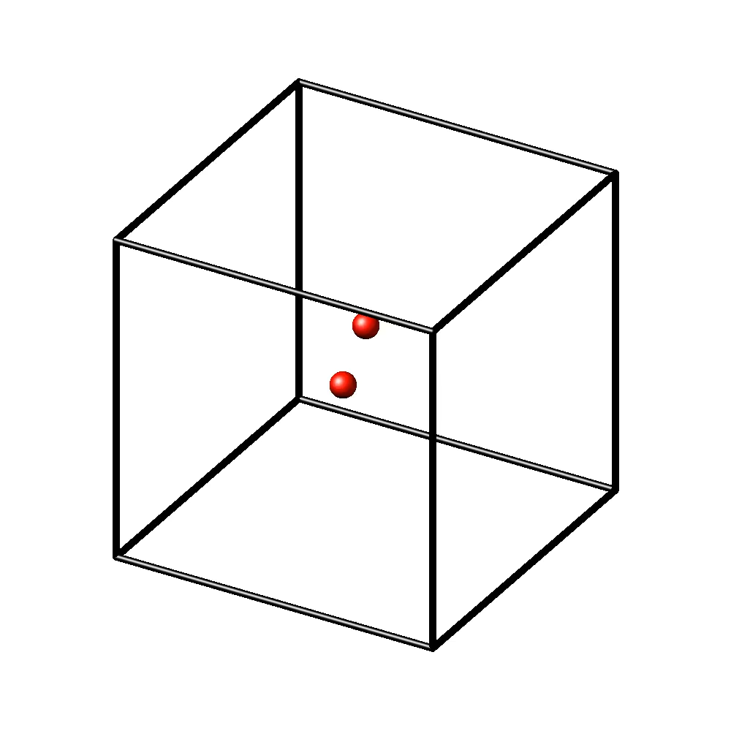
Example: 2-Body System: LAMMPS Graphical Output
Movie (mp4)

Slide 17
Example: 3-Body System
# this keeps particles inside the box!
fix W all wall/reflect xlo EDGE xhi EDGE ylo EDGE yhi EDGE zlo EDGE zhi EDGE
# label particles to have different interaction strengths
# specify wildcard, but can override
pair_style yukawa 0.00001 50.0
pair_coeff * * 0.0 50.0
pair_coeff 1 2 -20.0 50.0
pair_coeff 1 3 -20.0 50.0
pair_coeff 2 3 -5.0 20.0
# give the particles different colors and sizes
dump M all movie 500 movie.mp4 type type size 1000 1000 view 60 120
dump_modify M backcolor white boxcolor black
dump_modify M acolor 1 red # color of particle 1
dump_modify M acolor 2 blue
dump_modify M acolor 3 green
dump_modify M adiam 1 10.0 # display diameter of particle 1
dump_modify M adiam 2 5.0
dump_modify M adiam 3 5.0

Slide 18
Example: 3-Body System
3 atoms # now 3
0 bonds
0 angles
0 dihedrals
3 atom types # can label differently
0 bond types
0 angle types
0 dihedral types
-40 40 xlo xhi
-40 40 ylo yhi
-40 40 zlo zhi
Masses
1 10000.0
2 100.0
3 100.0
Atoms
1 1 0 0 0
2 2 0 0 5
3 3 0 0 -7
Velocities
1 0 0 0
2 0.25 0 -0.25
3 -0.25 0 0.25

Slide 19
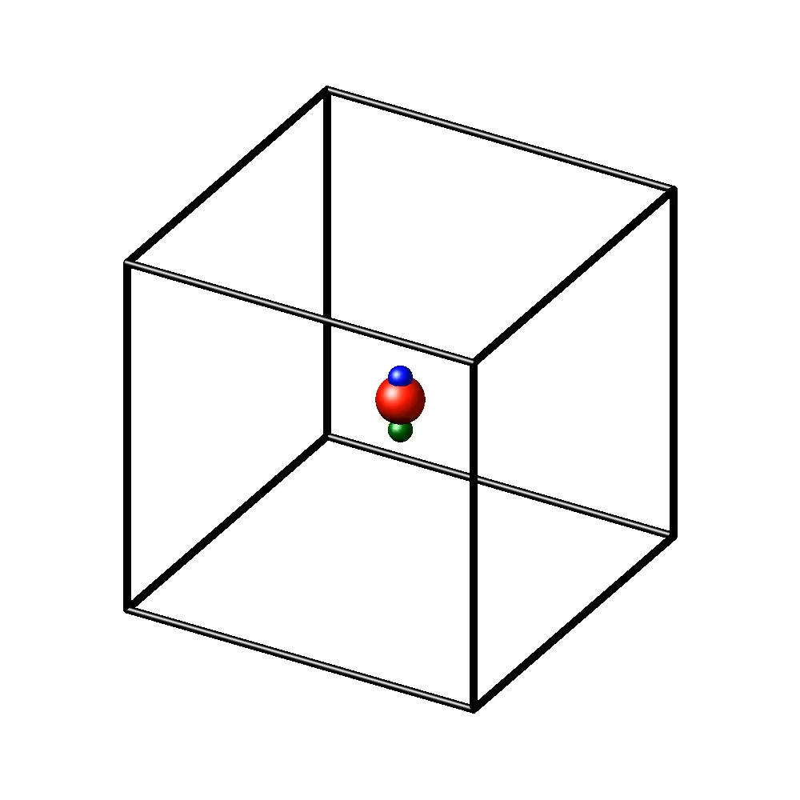
Example: 3-Body System: One Common Error
Try removing the reflective wall by commenting out the “fix wall line.
With reflection
Without reflection
ERROR: Lost atoms: original 3 current 1 (src/thermo.cpp:481)
Last command: run 200000
This is a common error!
Absence of wall (add the wall)
Violent recoil of one particle from another (fix the potential or decrease time step)

Slide 20
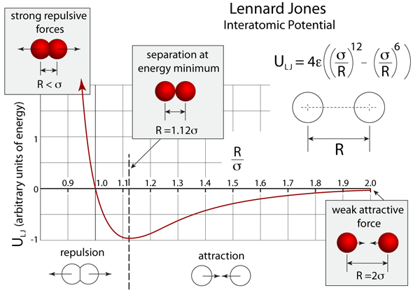
Example: Lennard-Jones System (1)
Describes semi-quantitatively many inter-atomic interactions
A useful starting point for molecular interactions

Slide 21

Example: Lennard-Jones System (1)
Applications:
Gases, liquids, and solids.
Materials science.
Phase transitions, adsorption, and diffusion phenomena.
Polymers and biomolecules
LJ is a “pretty good” approximation of many liquids and gases, to the extent that it is a ‘standard’:
https://www.nist.gov/mml/csd/chemical-informatics-group/lennard-jones-fluid-properties

Slide 22
Example: Lennard-Jones System (1)
# now periodic boundary conditions
boundary p p p
# specify initial position lattice
# no separate file needed here!
# and specify concentration
lattice sc 0.3
# specify geometric region (a cube)
region myregion block 0 10 0 10 0 10
# tell LAMMPS this is simulation volume
create_box 1 myregion
# put the atoms in the box
create_atoms 1 box
# specify mass here
mass 1 1.0
# LJ potential
pair_style lj/sf 2.5 # default cutoff
pair_coeff 1 1 0.5 1.0 2.5 # specify neighbor parameter
neighbor 0.3 bin
neigh_modify every 20 delay 0 check yes
fix F1 all nve # (equations of motion)
# output of all atom positions per 1000 steps
dump D1 all custom 1000 atom.dat id type x y z
# running listing of thermo parameters
thermo 1000
thermo_style custom step temp pe ke etotal
timestep 0.005
run 100000

Slide 23
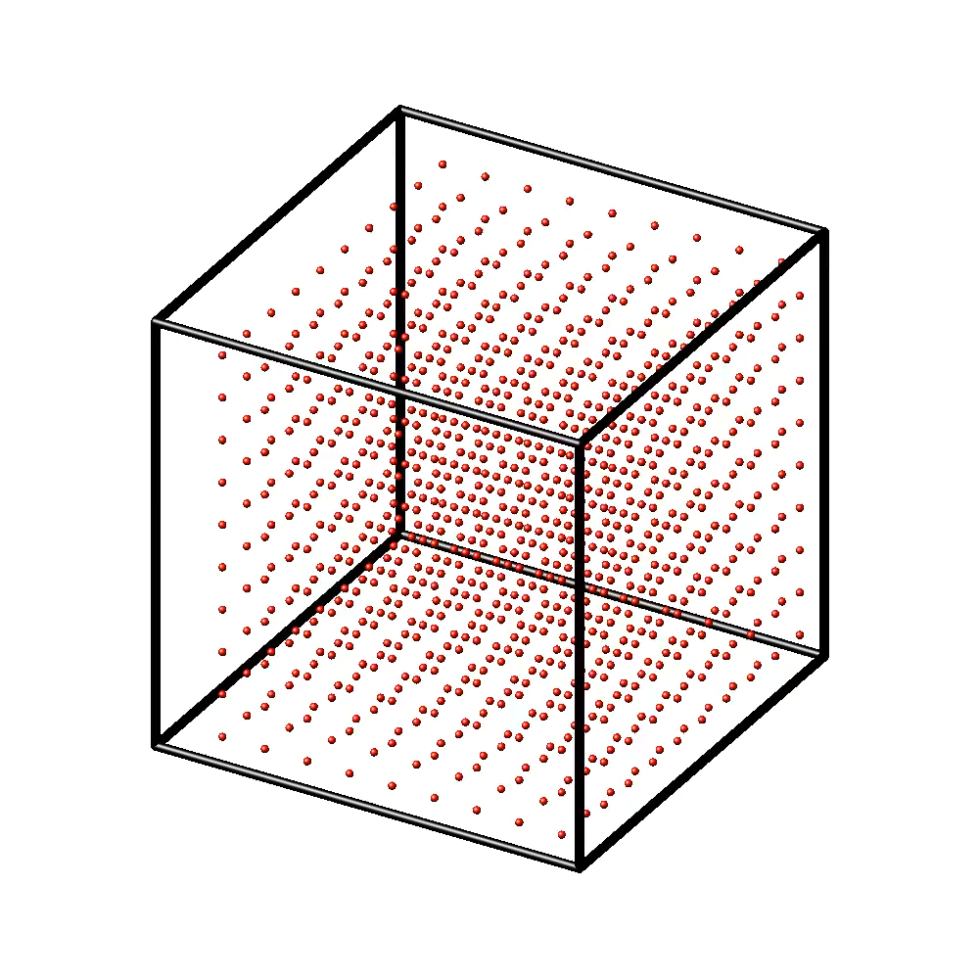
Example: Lennard-Jones System (1): Output
Step Temp PotEng KinEng TotEng
0 0 -0.4472629 0 -0.4472629
1000 2.1508437e-22 -0.4472629 3.2230393e-22 -0.4472629
2000 1.3968914e-08 -0.44726292 2.0932418e-08 -0.4472629
3000 0.19217331 -0.73525546 0.2879717 -0.44728375
***
99000 0.42357295 -1.0820611 0.63472406 -0.44733708
100000 0.43462202 -1.0986219 0.6512811 -0.44734076

Slide 24
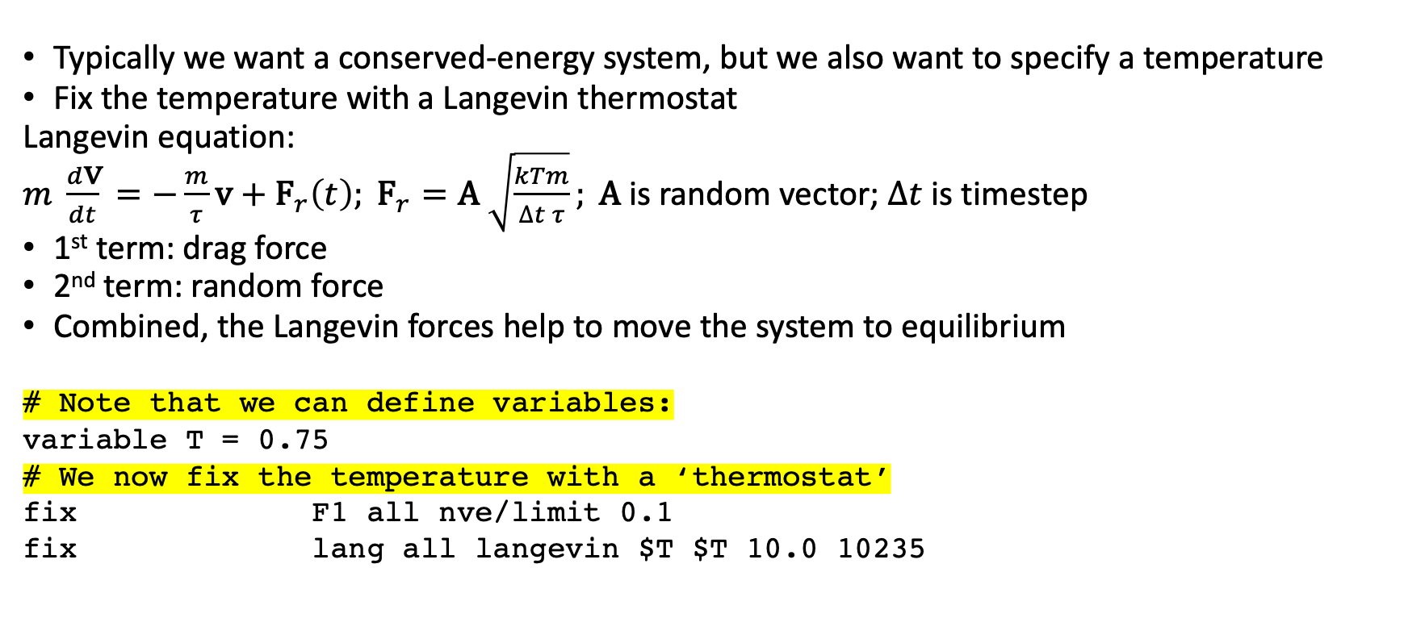
Example: Lennard-Jones System (2)
Typically we want a conserved-energy system, but we also want to specify a temperature
Fix the temperature with a Langevin thermostat
Langevin equation:
$m \frac{d\text{v}}{dt} =−\frac{m}{τ}\text{v} \text{+ }{\text{F}}_{r}\left(t\right); {\text{F}}_{r}=\text{A} \sqrt{\frac{kTm}{∆t τ}}; \text{A}$ is random vector; $∆t$ is timestep
1st term: drag force
2nd term: random force
Combined, the Langevin forces help to move the system to equilibrium
# Note that we can define variables:
variable T = 0.75
# We now fix the temperature with a ‘thermostat’
fix F1 all nve/limit 0.1
fix lang all langevin $T $T 10.0 10235

Slide 25

Example: Lennard-Jones System (2): Output
# trajectory file atom.dat:
ITEM: TIMESTEP
0
ITEM: NUMBER OF ATOMS
1000
ITEM: BOX BOUNDS pp pp pp
0.0000000000000000e+00 2.1544346900318839e+01
0.0000000000000000e+00 2.1544346900318839e+01
0.0000000000000000e+00 2.1544346900318839e+01
ITEM: ATOMS id type x y z
1 1 0 0 0
2 1 2.15443 0 0
3 1 4.30887 0 0
4 1 6.4633 0 0
5 1 8.61774 0 0
-etc

Slide 26
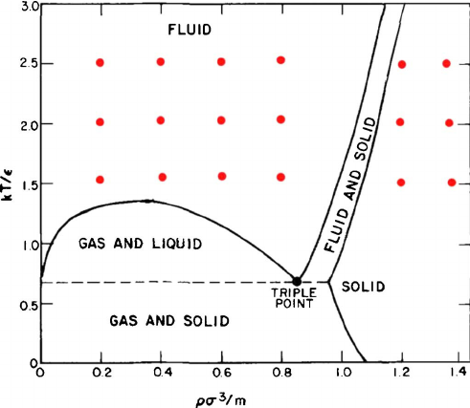
Example: Lennard-Jones System (2): Phase Diagram

Slide 27
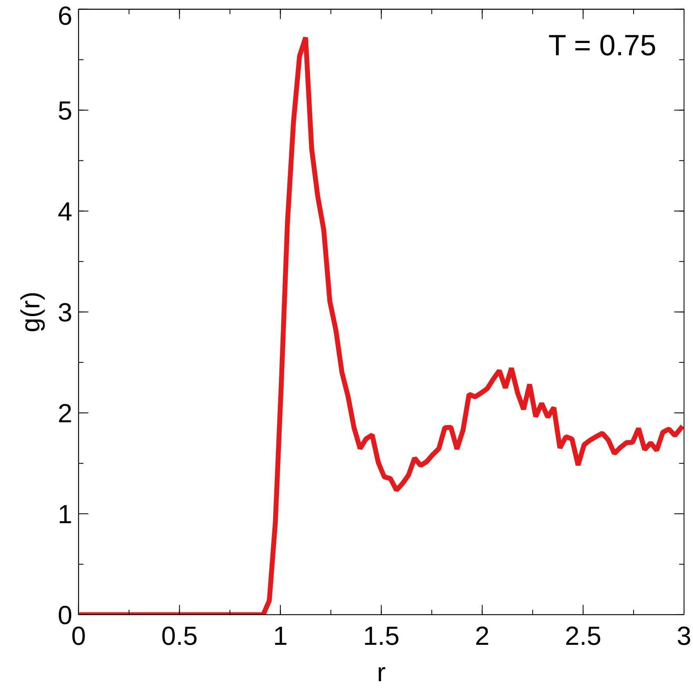
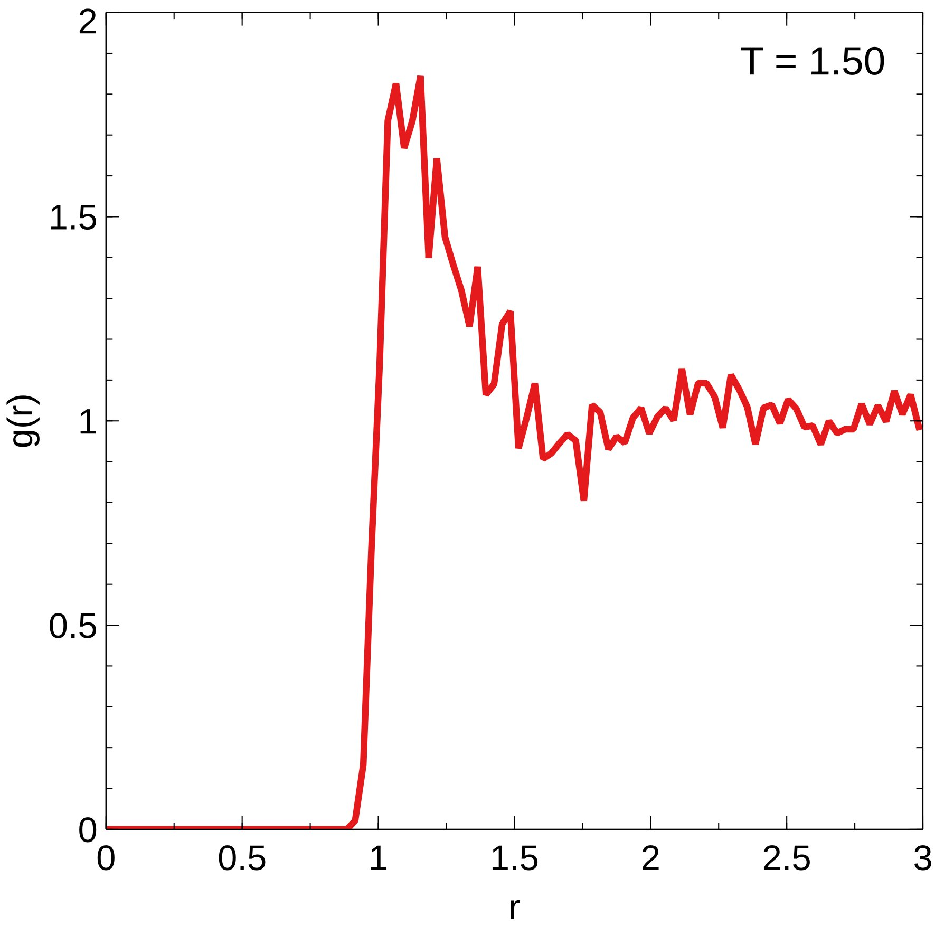
Radial distribution function g(r) (1000 atoms)
liquid
fluid/gas

Slide 28
Example: Polymer System (1)
Simple model of polymers by Rouse model: beads on a string, attached by springs
Two issues to start with:
Must specify bond information
Not a uniform system: must specify all bead coordinates: in practice, use/write a program to do this (my C++ source code available in src folder after examples)
# atom_style changes because there are bonds
atom_style molecular
# now must include init file with all coordinates
read_data poly.init
# interactions and bond values usually specified separately
include interactions
# otherwise similar to LJ examples
variable T equal 1
-etc-
timestep 0.01
run 50000
The model: 5x5 polymers with 20 ‘beads’ each (500 total)

Slide 29
Example: Polymer System (1)
500 atoms
475 bonds
0 angles
0 dihedrals
0 impropers
2 atom types
1 bond types
0 angle types
0 dihedral types
0 improper types
-15 15 xlo xhi
-15 15 ylo yhi
-15 15 zlo zhi
Masses
1 1
2 1
Atoms
1 1 1 -7.85 -12 -12
2 1 1 -6.85 -12 -12
3 1 1 -5.85 -12 -12
-etc-
Velocities
1 0 0 0
2 0 0 0
3 0 0 0
4 0 0 0
5 0 0 0
Bonds
1 1 1 2
2 1 2 3
3 1 3 4
4 1 4 5
5 1 5 6
6 1 6 7
7 1 7 8
8 1 8 9
9 1 9 10
-etc-
poly.init

Slide 30
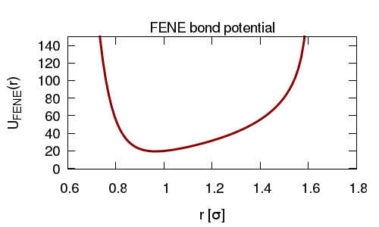
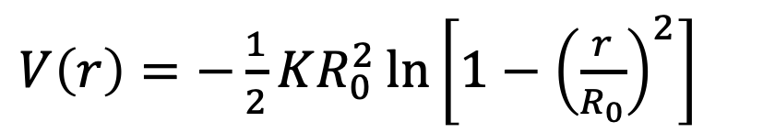
Example: Polymer System (2)
Difficulties with previous example:
Rouse springs are a good first approximation, but in practice bonds have limited extension.
Address this with a FENE (finite extensible non-linear elastic) interaction:
This makes the simulation more realistic, but there’s a risk of breaching the log singularity: if you do, the LAMMPS simulation crashes (if you get close, there’s a warning).
$V\left(r\right)=−\frac{1}{2}KR_{0}^{2}\ln\left[1−{\left(\frac{r}{R_{0}}\right)}^{2}\right]$

Slide 31
Example: Polymer System (2)
Difficulties with previous example:
Polymers can be very long and folded inside small volume
The initial configuration must put the polymer entirely inside the volume, AND must respect the FENE singularities
Address both issues with “soft interactions”:
No singularities or hard cores
Start the simulation with polymers in compressed (perhaps linear) state that is easy to program, with very short (unrealistic) separations
Run the simulation with soft interactions until the polymer expands to realistic length (folded, coiled) and separations
Then turn on real potentials

Slide 32
Example: Polymer System (2)
#input configuration ignores spacing limits
read_data poly.init
fix W all wall/reflect xlo EDGE xhi EDGE ylo EDGE yhi EDGE zlo EDGE zhi EDGE
# soft interactions here
include softinteractions
fix 1 all nve/limit 0.05
fix 2 all langevin $T $T 1.0 8147237
run 1000
# now turn on ‘real’ interactions
include interactions
unfix 1
fix 1 all nve/limit 0.05
timestep 0.01
run 18000

Slide 33
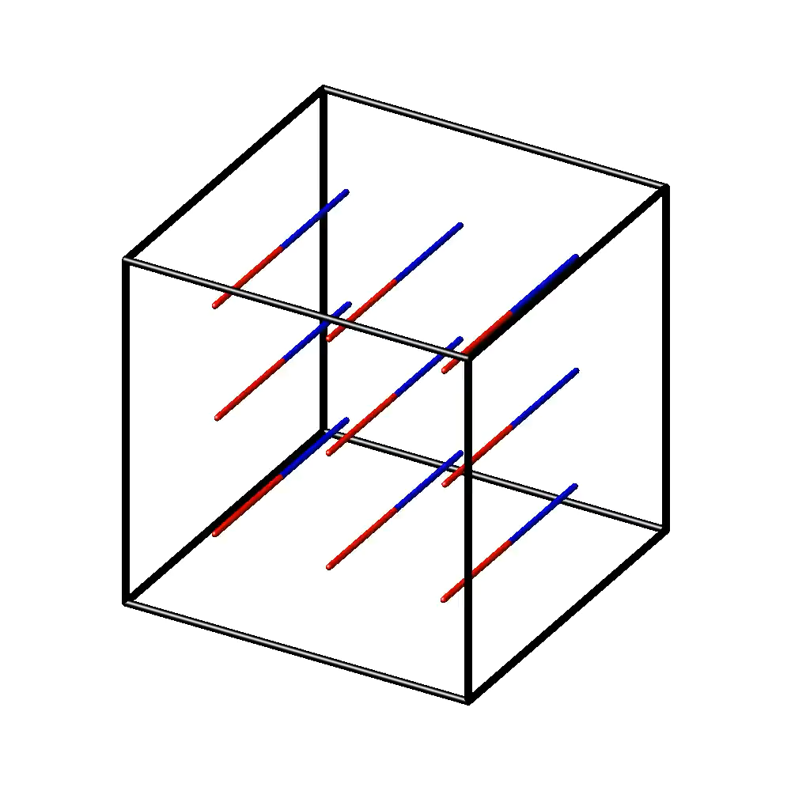
Example: Polymer System (2)
full run
short run

Slide 34
Example: Two Chromosomes in Cell Nucleus
Like the polymer examples, but
Specify regular elements, telomeres, centromere and spindle pole body (SPB), tethered to the centromere
Spherical nuclear envelope
Must provide a wall so that units don’t escape
Provide attraction between wall and telomeres
In this model there is TT attraction
As with Poly3, must ‘condition’ the system with ‘soft’ interactions
C++ code included in src folder

Slide 35
Example: Two Chromosomes in Cell Nucleus
#long cutoff
comm_modify mode single cutoff 20.0
include variables
include softinteractions
# groupings by particle type
# 1: Ch 1; 2: Ch 2; 3: telomere; 4: centromere; 5: SPB; 6: fake particles to show sphere
group particle type 1 2 3 4
group normal type 1 2 4
group centro type 4
group telo type 3
# sphere radius
variable rad equal 30
# region inside sphere
region mySphere sphere 0.0 0.0 0.0 v_rad side in
# set up potentials with the wall
fix walln normal wall/region mySphere lj126 ${eps_ne} ${sigma_ne} ${cut_ne}
fix wallt telo wall/region mySphere lj126 ${eps_te} ${sigma_te} ${cut_te}
# give particle different colors & sizes
dump_modify M backcolor white boxcolor black
dump_modify M adiam * 0.75
dump_modify M adiam 3 2.0
dump_modify M adiam 4 2.0
-etc-

Slide 36
Example: Two Chromosomes in Cell Nucleus
# scheme: ramp up very carefully by increasing nve/limit
# simulation will run more slowly during this phase
# may still get FENE warnings
# moving too fast will yield
# FENE bond ERROR (not warning: simulation crashes)
# missing bond atom (simulation crashes)
run 10000
include interactions
unfix 1
fix 1 particle nve/limit 0.0001
run 10000
unfix 1
fix 1 particle nve/limit 0.0005
run 10000
unfix 1
# final production parameters
fix 1 particle nve/limit 0.05
run 450000

Slide 37
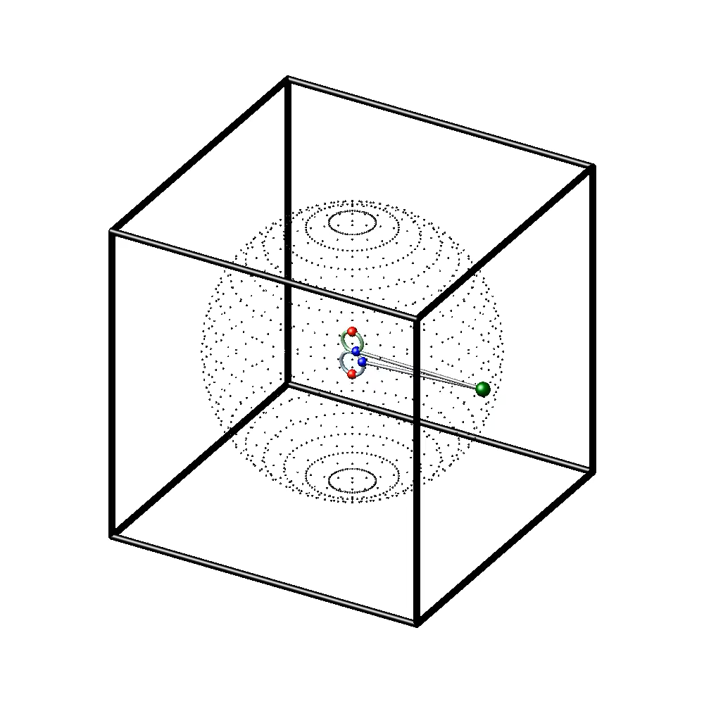
Example: Two Chromosomes in Cell Nucleus

Slide 38
Summary
LAMMPS is a very powerful computing package with many applications
It has a large set of options, one reason why there’s a learning curve to get LAMMPS to do what exactly you want
I’ve shown mostly movies, but the real power of LAMMPS is the extent of its quantitative output for post-production analysis in parallel with experiments.

Slide 39
Going forward…
You can download the examples to your local drive from Google Colab; see commented cell at the end of the notebook.
You can also get copies of the examples directly at GitHub at the Linux command prompt:
$ git clone https://github.com/BKFC90/Chrom2023
LAMMPS examples
https://docs.lammps.org/Examples.html
LAMMPS movies
https://www.lammps.org/movies.html
Visualization packages (many) such as VMD that analyze LAMMPS output
https://www.ks.uiuc.edu/Research/vmd/

